Slide 1
Regular expressions and Context Free grammars

Slide 2
What do we need to figure out?
How do we define a language? i.e. a language specification?
How do we write a program (in the same or another language) to
Read the program source
Check it for adherence to the language specification
Determine its structure
Determine its meaning
Translate it to machine code
For any program written in the language!

Slide 3
Language Definition
Syntax is the structure of a language, i.e., the form that each program or source code file must take.
Since the early 1960s, syntax has been given as a set of grammar rules in a form developed by Noam Chomsky, John Backus, and Peter Naur. (Context-free grammar, Backus Naur Form [BNF and EBNF].)
Syntax includes the definition of the words, or tokens, of the language, which can be called its lexical structure.
Both lexical and syntactic structure have precise mathematical definitions that every computer scientist should know.

Slide 4
Lexical Structure
Recognizes consecutive characters that form a unit and groups them into tokens.
Tokens are the building blocks of syntax: the “words” of the language.
Tokens are recognized by the first phase of a translator (compiler) -- the scanner -- which is the only part of the translator that deals directly with the input. The scanner groups the input characters into tokens. (Scanners are sometimes called lexers.)
Tokens can be defined using either grammar rules or regular expressions.
Regular expressions are used in many areas of computer science to describe text patterns. One example: grep (“global regular expression print”).

Slide 5
Standard Token Categories
Reserved words, sometimes called keywords, such as if and while
Literals or constants, such as 42 (a numeric literal) or "hello" (a string literal)
Special symbols, such as “;”, “<=”, or “+”
Identifiers, such as x24, monthly_balance, or putchar

Slide 6
White space and comments
“Internal” tokens of the scanner that are matched and discarded
Typical white space: newlines, tabs, spaces
Comments:
/* … */, // … \n (C, C++, Java)
-- … \n (Ada, Haskell)
(* … *) (Pascal, ML)
; … \n (Scheme)
Comments generally not nested.
Comments & white space ignored except they function as delimiters (or separators).

Slide 7
Reserved words versus predefined identifiers
Reserved words cannot be used as the name of anything in a definition (i.e., as an identifier).
Predefined identifiers have special meanings, but can be redefined (although they probably shouldn’t).
Examples of predefined identifiers in Java: anything in java.lang package, such as String, Object, System, Integer.

Slide 8
Java reserved words
abstract default if private this
boolean do implements protected throw
break double import public throws
byte else instanceof return transient
case extends int short try
catch final interface static void
char finally long strictfp volatile
class float native super while
const for new switch
continue goto package synchronized

Slide 9
Regular expression rules
Base case: a regular expression (RE) is either
➡ a character (e.g., ʻ0ʼ, ʻ1ʼ, ...), or
➡ the empty string (i.e., ʻεʼ).
A compound RE is constructed by
➡ concatenation: two REs next to each other (e.g., “non_negative_digit digit”),
➡ alternation: two REs separated by “|” next to each other (e.g., “non_negative_digit | digit”),
➡ optional repetition: a RE followed by “*” (the Kleene star) to denote zero or more occurrences, and
➡ parentheses (in order to avoid ambiguity).

Slide 10
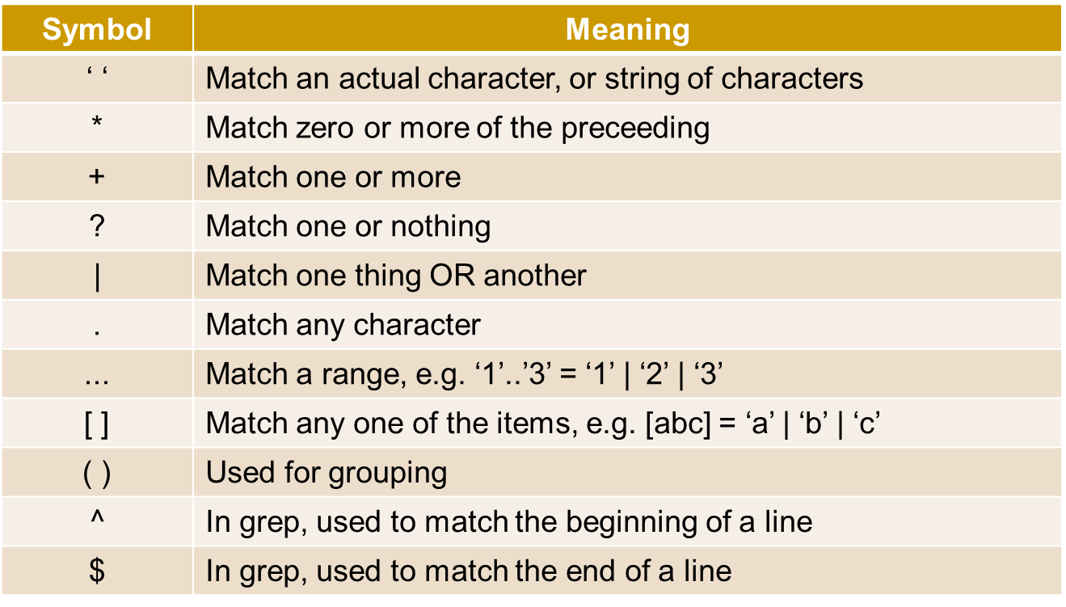
Regular expressions - Symbols

Slide 11
Context free grammar
A context-free grammar, or simply grammar, has four parts:
A set of tokens or terminals.
A set of nonterminals.
A set of productions (production rules) for identifying the components of a construct. Each production has a nonterminal as its left side and a string over the sets of terminals and nonterminals as its right side.
A nonterminal chosen as the starting nonterminal.
Notation for CFG is Backus Naur Form

Slide 12
Terminology
Left-hand sides (before the →) are called nonterminals or structure names.
Right-hand sides (after the →) are strings of tokens and nonterminals, sometimes called symbols. (Metasymbols with special meanings can also sometimes appear.)
Tokens are sometimes called terminals.
Grammar rules themselves are sometimes called productions, since they "produce" the language.
Metasymbols are the arrow → (“consists of”) and the vertical bar | (choice).
One nonterminal is singled out as the start symbol: it stands for a complete unit in the language (sentence, program).

Slide 13
Context-free grammars
(1) sentence → noun-phrase verb-phrase .
(2) noun-phrase → article noun
(3) article → a | the
(4) noun → girl | dog
(5) verb-phrase → verb noun-phrase
(6) verb → sees | pets

Slide 14
CFGs generate “languages”:
The language of a CFG is the set of strings of terminals that can be generated from the start symbol by a derivation:
sentence ⇒ noun-phrase verb-phrase . (rule 1)
⇒ article noun verb-phrase . (rule 2)
⇒ the noun verb-phrase . (rule 3)
⇒ the girl verb-phrase . (rule 4)
⇒ the girl verb noun-phrase . (rule 5)
⇒ the girl sees noun-phrase . (rule 6)
⇒ the girl sees article noun . (rule 2)
⇒ the girl sees a noun . (rule 3)
⇒ the girl sees a dog . (rule 4)

Slide 15
CFGs can be recursive:
expr → expr + expr | expr ∗ expr | ( expr ) | number
number → number digit | digit
digit → 0 | 1 | 2 | 3 | 4 | 5 | 6 | 7 | 8 | 9
or
expr → expr + expr | expr ∗ expr | ( expr ) | NUMBER
NUMBER = [0-9]+

Slide 16
Notes:
Recursion can be used to get simple repetition (Example 1):
number ⇒ number digit ⇒ number digit digit
⇒ digit digit digit ⇒ 2 digit digit
⇒ 23 digit ⇒ 234
Recursion is more powerful than just simple repetition (Example 2):
expr ⇒ expr * expr ⇒ ( expr ) * expr
⇒ ( expr + expr ) * expr ⇒ ...
⇒ (2 + 3) * 4

Slide 17
Derivations
DEMO

Slide 18
Parse Trees
Derivations express the structure of syntax, but not very well: there can be lots of different derivations for the same structure, e.g. Example 1 could have been:
number ⇒ number digit ⇒ number 4
⇒ number digit 4 ⇒ number 34
⇒ digit 34 ⇒ 234
A parse tree better expresses the structure inherent in a derivation.
Two sample parse trees on next slide.

